Slide 1
Foodify – Online Food Ordering System
By STANIO.A 43111226

Slide 2
ABSTRACT
Foodify is a comprehensive web-based application designed to revolutionize how customers order food from restaurants. The system enables users to explore menus, customize their meals, and place orders conveniently from anywhere using an intuitive digital platform. Restaurants can efficiently manage incoming orders, update menus, and handle payments through a centralized dashboard.
This project aims to reduce human error, optimize order management, and improve communication between restaurants and customers. Foodify offers real-time order updates, estimated delivery tracking, and digital payment integration, making it a robust solution for both small and large-scale restaurants. The platform is scalable, adaptable, and designed with responsive web technologies to ensure a smooth experience across all devices.

Slide 3
EXISTING SYSTEM
Currently, most small and medium restaurants rely on manual or semi-digital systems for managing orders. Customers typically place orders via phone calls or third-party delivery apps, which often result in miscommunication and delays. Restaurant staff need to manually record orders, check inventory, and update kitchen staff, which increases the chance of human error.
Additionally, existing third-party platforms charge high commissions and lack customization for restaurants to manage their unique requirements. Customers also face inconvenience when there are discrepancies in menu availability or order status. The absence of a unified, restaurant-owned system limits customer loyalty and reduces profit margins for business owners.
Thus, the need for a reliable, customizable, and efficient digital ordering system like Foodify has become essential for the modern food industry.

Slide 4
PROPOSED SYSTEM
Foodify introduces a fully automated online platform that integrates user-friendly ordering, efficient restaurant management, and real-time tracking. The proposed system bridges the gap between customers and restaurants by eliminating manual dependency and providing transparency throughout the ordering process.
Users can browse through restaurant menus, add dishes to their cart, apply discount codes, and make secure payments. The backend handles order processing, user authentication, and data storage using Node.js and MongoDB, ensuring scalability and security. The frontend, developed using HTML, CSS, and JavaScript, provides a visually appealing and responsive design optimized for both desktop and mobile.
Restaurants benefit from an admin dashboard that allows them to update menus, view customer insights, and manage orders effectively. Foodify also provides future potential for integrating delivery tracking, AI-based food suggestions, and customer feedback analysis to improve service quality.

Slide 5
ADVANTAGES
• Streamlined and time-saving ordering process for customers.
• Enhanced efficiency in restaurant management through automation.
• Real-time updates and transparent tracking of orders.
• Reduced human dependency and minimized communication errors.
• Secure payment gateway integration to ensure user trust and safety.
• Customizable interface adaptable to restaurant branding.
• Centralized database enabling data-driven insights and analytics.
• User-friendly interface built with accessibility in mind.
• Future scalability with modules for loyalty programs and discounts.

Slide 6
DISADVANTAGES
• Dependence on stable internet connectivity for smooth operation.
• High initial development and setup cost for smaller restaurants.
• Requires regular technical maintenance and updates to ensure performance.
• Security vulnerabilities may arise if backend protection is not managed properly.
• Downtime or bugs in the system could affect user experience.
• Limited offline functionality, restricting accessibility during network failures.

Slide 7
HARDWARE REQUIREMENTS
• Processor: Intel Core i5 or higher for smooth application performance.
• RAM: Minimum of 4 GB (8 GB recommended) to handle web server and database operations.
• Storage: Minimum of 250 GB to store logs, images, and database entries.
• Network: Broadband or fiber-optic internet with minimum 10 Mbps speed.
• Display: Full HD monitor with resolution of 1366x768 or higher.
• Optional: External backup device or cloud service for database redundancy.

Slide 8
SOFTWARE REQUIREMENTS
• Frontend Technologies: HTML5, CSS3, JavaScript (React or vanilla JS).
• Backend Technologies: Node.js, Express.js for RESTful API development.
• Database: MongoDB for storing user profiles, menus, and order history.
• Payment Gateway Integration: Razorpay / Stripe API.
• Server Environment: Localhost or cloud-based server (AWS, Heroku, or Render).
• Tools and IDEs: Visual Studio Code, npm, Git, Postman for API testing.
• Operating System: Windows, macOS, or Linux compatible environment.

Slide 9
MODULES
1.User Module – Manages user registration, login, profile updates, and order history.
2. Menu Module – Displays available dishes with images, ingredients, and price.
3. Cart Module– Handles add/remove items, calculates total, and initiates checkout.
4. Payment Module – Integrates payment gateway APIs to handle secure transactions.
5. Admin Module – Allows restaurant staff to manage menu updates and process orders.
6. Notification Module – Sends order confirmation and delivery updates via email/SMS.
7. Analytics Module– Provides insights on sales, user activity, and most-ordered items.

Slide 10
MODULE DESCRIPTION
• User Module Handles customer authentication, account creation, and data encryption. Ensures secure storage of login credentials using hashing algorithms.
• Menu Module: Displays categorized menus (Starters, Main Course, Desserts, Beverages) dynamically fetched from the database. Admins can easily add or modify dishes.
• Cart Module: Implements real-time item count, dynamic price calculation, and discount code validation.
• Payment Module: Uses APIs like Stripe or Razorpay to ensure secure payments and provide receipts.
• Admin Module: Facilitates backend management for restaurants, including order updates and user support.
• Notification Module: Sends order and delivery updates using NodeMailer or third-party APIs.
• Analytics Module: Helps restaurants identify customer trends and optimize menu offerings.

Slide 11
Sample Output (Screenshots)
The Foodify user interface provides an elegant, minimal layout where customers can browse dishes with images, add items to the cart, and complete orders with just a few clicks. The homepage highlights featured dishes, restaurant offers, and a responsive navigation bar.
The admin dashboard includes metrics such as total orders, active users, and best-selling dishes. Real-time updates ensure smooth order tracking.

Slide 12
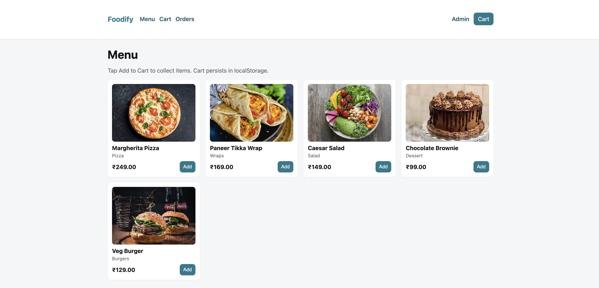
This is the main page of our site

Slide 13
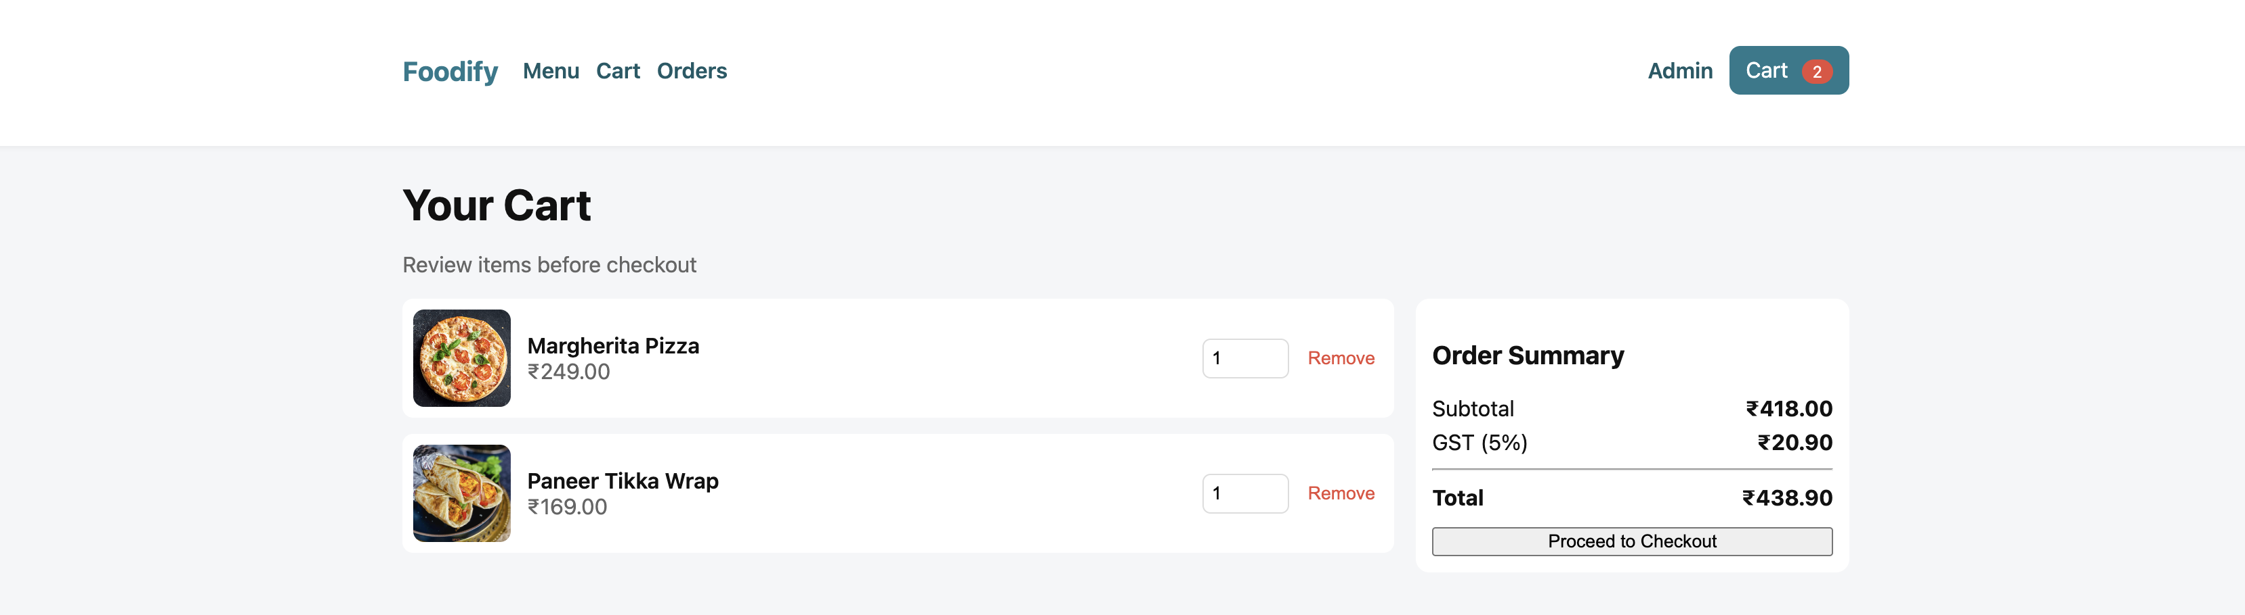

This is the cart page

Slide 14

This is the orders page

Slide 15
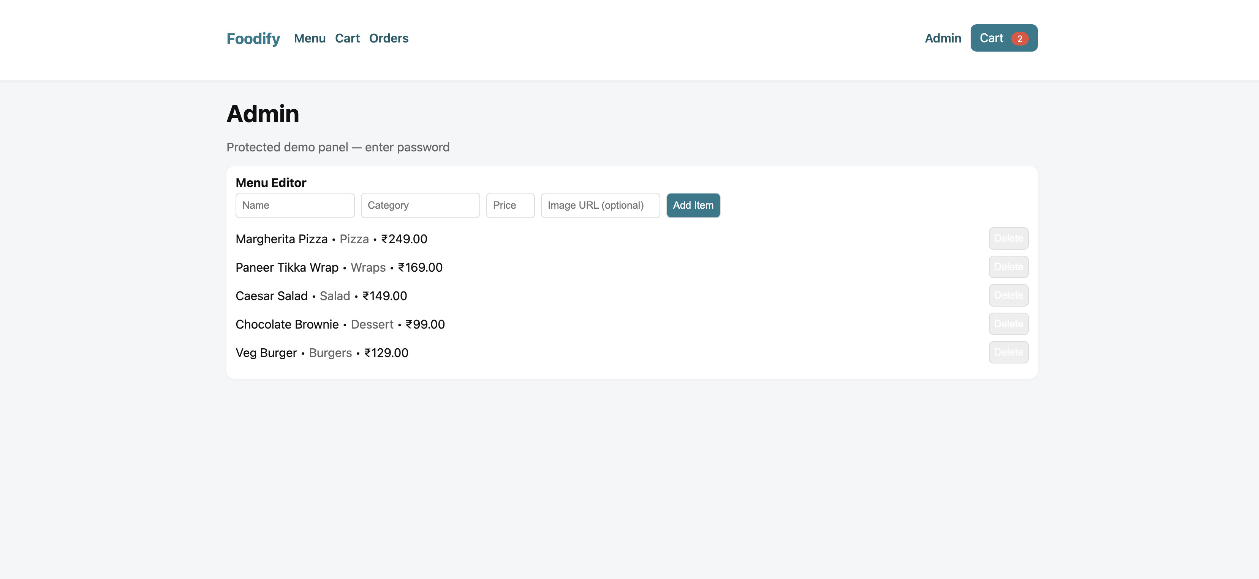
This is the admin page where we enter this by using a password and here we can add, delete, edit the menu items and their prices efficiently

Slide 16
CONCLUSION
Foodify transforms traditional food ordering into a digital, customer-friendly experience. It benefits both users and restaurants by automating order management, improving accuracy, and enhancing convenience. The system’s modular structure ensures scalability and maintainability for future expansions.
In future updates, Foodify can incorporate
AI-driven food recommendations
GPS-based delivery tracking
voice-ordering integration to enhance usability further. By combining modern web technologies with an intuitive design, Foodify aims to set a new benchmark for digital food ordering platforms.

